Slide 1

PYTHON DISTRIBUTION PACKAGE

Slide 2
TABLE OF CONTENT:-
Probability Distribution
Types of Probability Distribution
Identification of need
Advance OOP topics
Virtual Environment
Methodology
Steps to run and install the package
Future Scope
Conclusion

Slide 3
PROBABLITY DISTRIBUTION:-
Probability denotes the possibility of something happening. It is a mathematical concept that predicts how likely events are to occur.
In Statistics, the probability distribution gives the possibility of each outcome of a random experiment or event. It provides the probabilities of different possible occurrences.
Types of Probability Distribution
The probability distribution is divided into two parts:
1. Discrete Probability Distributions
2. Continuous Probability Distributions

Slide 4
TYPES OF PROBABLITY DISTRIBUTION:-
Discrete Probability Distribution
A discrete distribution describes the probability of occurrence of each value of a discrete random variable.
Binomial Distribution The binomial distribution is a discrete distribution with a finite number of possibilities.
Binomial Distribution Examples
To take a survey of positive and negative feedback from the people for anything.
To check if a particular channel is watched by how many viewers by calculating the survey of YES/NO.
The number of men and women working in a company.

Slide 5
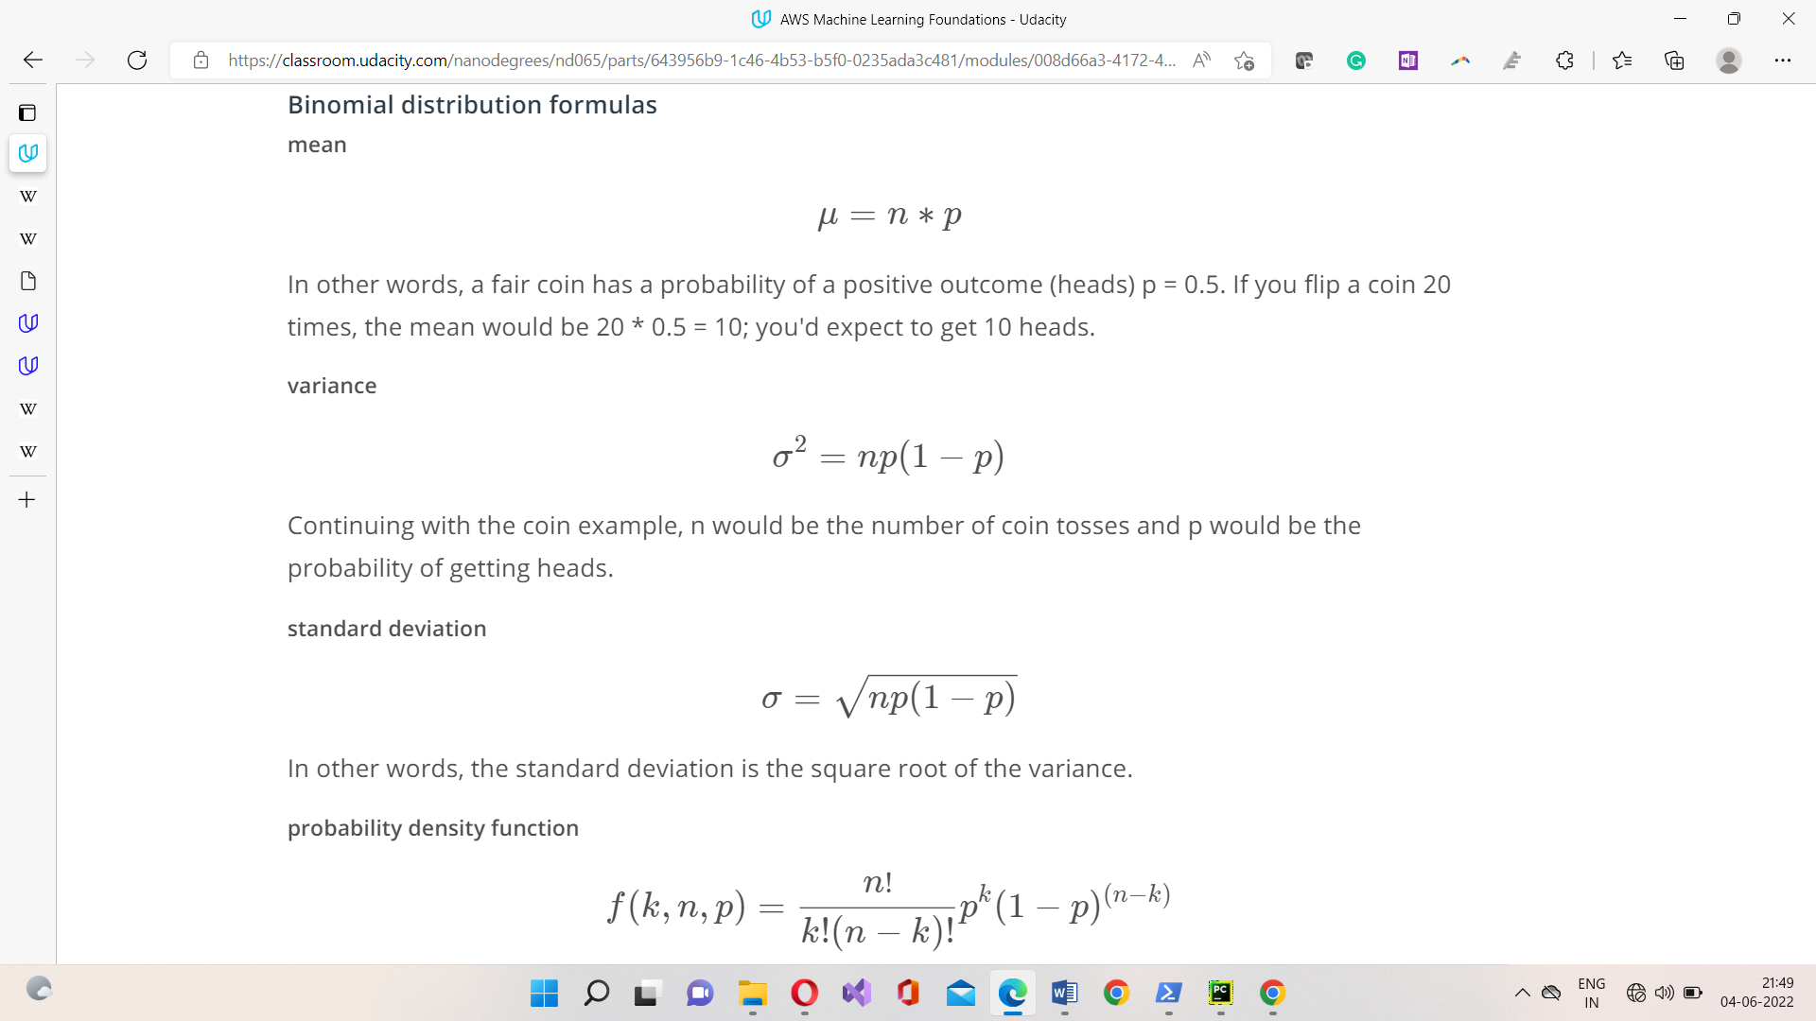

Slide 6
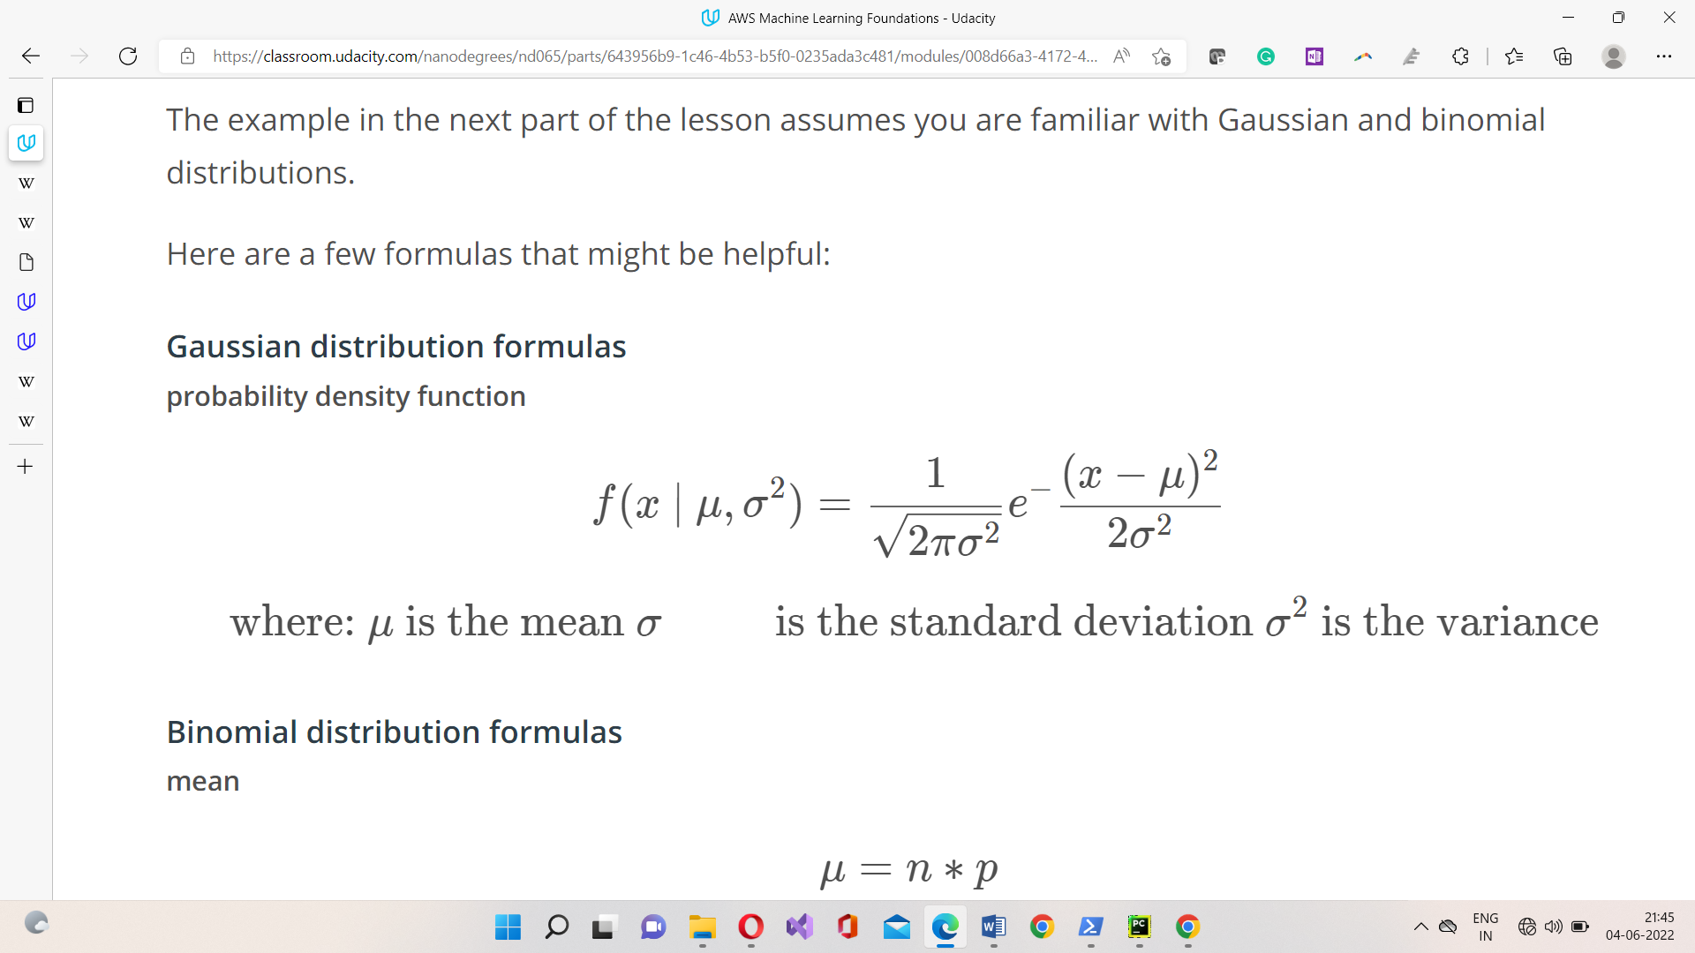
TYPES OF PROBABLITY DISTRIBUTION:-
2. Continuous Probability Distributions
A continuous distribution describes the probabilities of a continuous random variable's possible values. A continuous random variable has an infinite and uncountable set of possible values (known as the range).
Normal Distribution Normal Distribution is one of the most basic continuous distribution types. Gaussian distribution is another name for it. Around its mean value, this probability distribution is symmetrical. It also demonstrates that data close to the mean occurs more frequently than data far from it.
Binomial Distribution Examples
Rolling a dice (once or multiple times)
Tossing a coin

Slide 7
IDENTIFICATION OF NEED:-
This package will contain code to analyse Gaussian distribution you can also use a package to read a dataset and calculate the mean and standard deviation. You will also include code to plot a histogram of the dataset, as well as a probability density function of a Gaussian distribution. Finally, this package will be able to add two Gaussian distribution together. You can install it by using pip install using terminal. It is not mandatory to upload the package to pypi(repository where all python package are stored for the general public to download and install).

Slide 8
Advanced OOP topics
Inheritance is the last object-oriented programming topic in the lesson. Thus far you've been exposed to:
Classes and objects
Attributes and methods
Magic methods : It lets you override and customize default python behaviour of the initialized methods of python
Inheritance : The distribution class takes care of the initialization and the read_data_file method.

Slide 9
Virtual Environment
A virtual environment is a silo-ed Python installation apart from your main Python installation. That way you can install packages and delete the virtual environment without affecting your main Python installation.
Two different Python environment managers: conda and venv.
Conda does two things: manages packages and manages environments.
As a package manager, conda makes it easy to install Python packages, especially for data science.
venv is an environment manager that comes preinstalled with Python 3. pip is a package manager.

Slide 10
METHODOLOGY
DISTRIBUTION CLASS :Generic distribution class for calculating and visualizing a probability distribution.
GAUSSIAN CLASS : Gaussian distribution class for calculating and visualizing a Gaussian distribution. Here __init__, __add__, __repr__ are magic methods.
BINOMIAL CLASS : Binomial distribution class for calculating and visualizing a Binomial distribution.

Slide 11
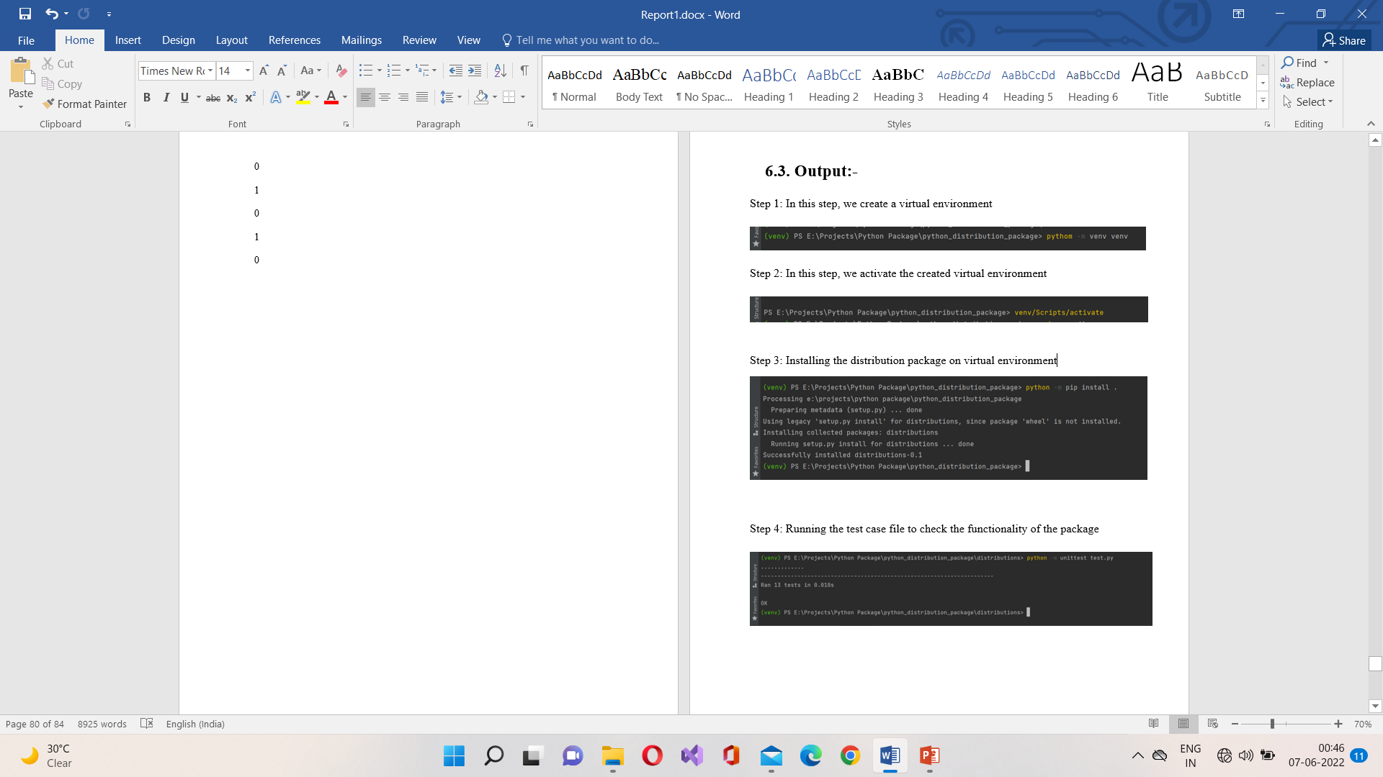
STEPS TO RUN AND INSTALL THE PACKAGE:-

Slide 12
FUTURE SCOPE :-
Furthermore, you can add more classes related to Probability distribution to enhance the functionality of the proposed package that can be developed to handle or perform more operations related to probability distribution. Also this package can be uploaded to official python repository pypi so that it can be available globally to all users as there is no such package exists to perform operations related to probability distribution.

Slide 13
CONCLUSION
The main objective of this package is to perform the Gaussian and binomial Probability distribution operations on the given dataset. The proposed package can be achieved by developing appropriate methods for calculating mean, standard deviation, plotting graphs, etc. From the results of the project, by passing a test file for checking all the operations are correct we can come to a conclusion that the both the classes operations were successfully executed from the test cases passed. Gaussian and Binomial both classes have calculated the correct answers with respect to the operations they are performing and all test cases are also passed as well.

Slide 14
THANK YOU

